Slide 1

LaunchCode Liftoff
Class 4
Hank DeDona
4/27/2020

Slide 2
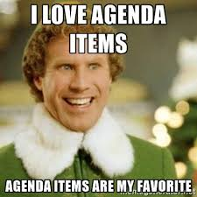
Agenda
Objectives and Timeline
Lecture
Live Coding
Code Review
Assignment: Project Review
Review Objectives and Q&A
Activity
Huddle
Paired Live Coding Practice
Project Review

Slide 3
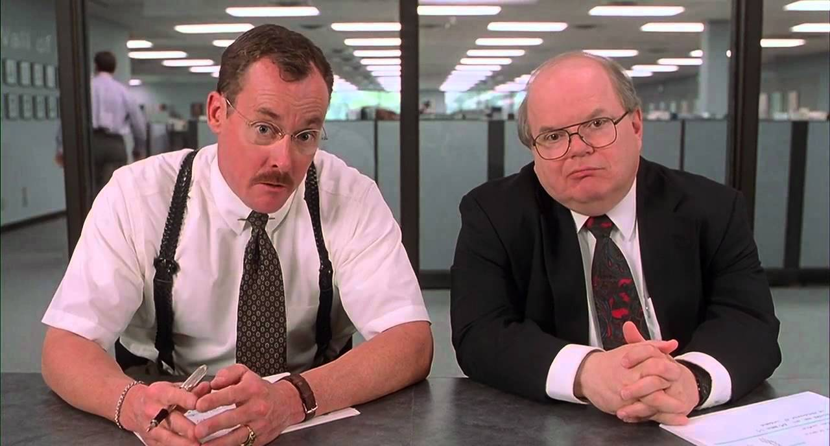
Objectives
Know what an interviewer is looking for from a live coding session
Explain the steps necessary for a successful live coding session
Know where to find prompts for live coding practice
Know how to give and receive good code review feedback

Slide 4
Liftoff Project Timeline
Capstone Project Selected
Initial Features
Class 1
Class 3
Class 2
Class 4
Wireframes & User Stories
Project Review 1

Slide 5
Liftoff Project Timeline
Address Feedback
Live Coding Interview
Next Features
Behavioral Interview
Class 5
Class 7
Class 6
Class 8
Next Features
Final Review
Notes:
Resume Aug 21st

Slide 6
Live Coding

Slide 7
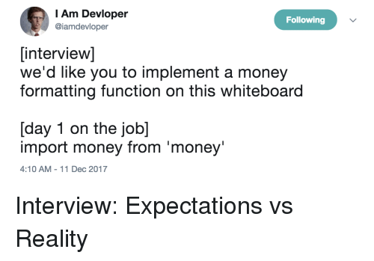
Live Coding - Introduction
Why
Live Coding Interview is Likely
Mock Live Coding Interviews - John
Many Approaches
In-Person or Online
Whiteboard or Computer
IDE or Notepad
Google
Ask Before Interview!
Goals
Solve Problems
Collaborate

Slide 8
Live Coding - Goals
Interviewers are looking for candidates who...
...ask questions to fully understand the problem.
...work towards a correct solution.
...has an understanding of the language syntax.
...demonstrates how to test the solution.
...addresses any bugs.
...can communicate their thought process.

Slide 9

Live Coding - Process
Gather Requirements
Break Problem Down
Pseudocode
Write Syntax (sometimes)
Test & Make Changes
https://education.launchcode.org/liftoff/videos/live-coding/

Slide 10
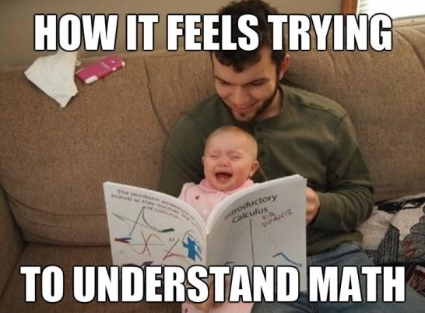
Gather Requirements
Ask Too Many Questions
Input/Output
Edge Cases/Validation
Write Out Requirements
Helpful Later
Establish Names & Data Structure

Slide 11
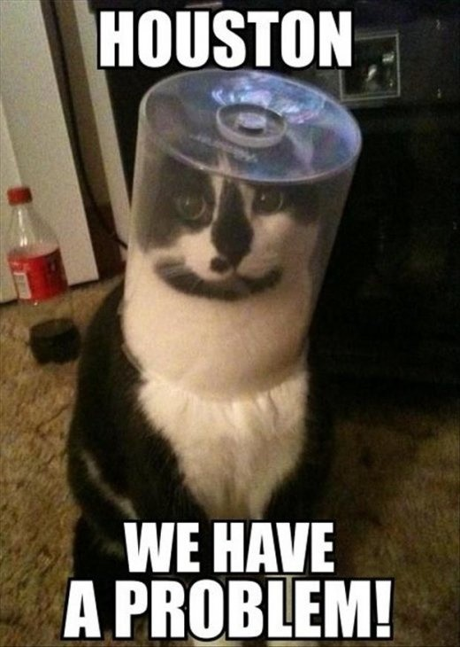
Break Problem Down
Restate The Key Points
Think out loud!
Rough Order Of Problems
Resist The Urge To Code
Stop, Turn Around, and Ask!

Slide 12
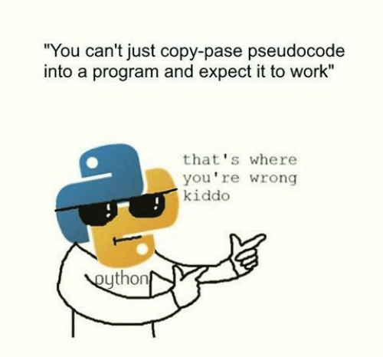
Pseudocode
No Code/Syntax
Still thinking out loud!
Focus On Control Structures
If/Then, Loops, etc
Examples
`If 5 is greater than 7, then stop`
`Loop from 1 to 100`
`If the result has a remainder, add 1`
`Print “hello world”`

Slide 13
Write Syntax
Now Start Writing Code
Talk It Out (Think out loud)
Don’t Be Afraid To Make Mistakes
Don’t Get Caught Up On Syntax
Write Clearly and Slowly

Slide 14
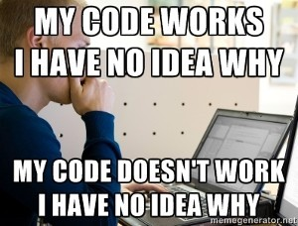
Test
Step Through Your Code (Out Loud)
Track Your Variables
Test Edge Cases
Shows thoroughness

Slide 15
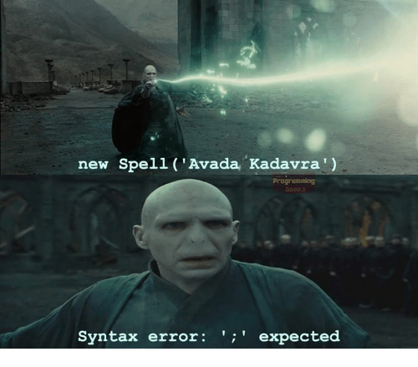
Make Changes
Fix Any “bugs” or missed branches
Discuss Improvements & Enhancements

Slide 16
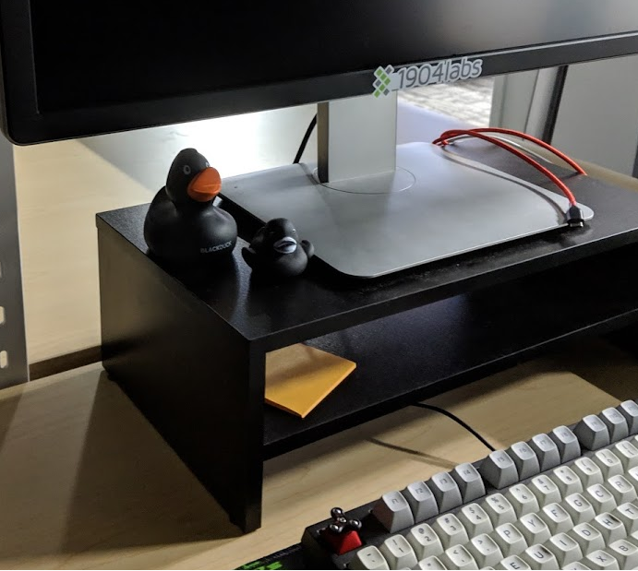
Practice Makes Perfect
https://www.hackerrank.com/
https://leetcode.com/
http://exercism.io/
https://checkio.org/

Slide 17
Demo - Live Coding

Slide 18
FizzBuzz
Write a program that prints the numbers from 1 to 100. But for multiples of three print "Fizz" instead of the number and for the multiples of five print "Buzz". For numbers which are multiples of both three and five print "FizzBuzz".

Slide 19
Code Reviews

Slide 20
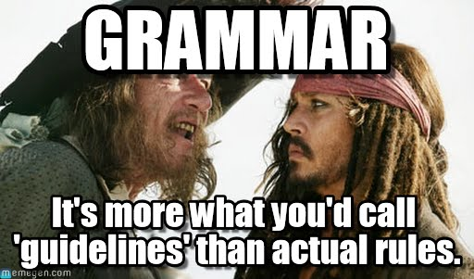
Clean Code Best Practices
Remove Dead Code
Clear Method & Variable Names
Encapsulate Duplicated Logic (DRY)
Comments Explain Why Not How
Clear Commit Messages
Spacing and formatting helps
Note: Teams will usually have predefined formatting/spacing/naming

Slide 21
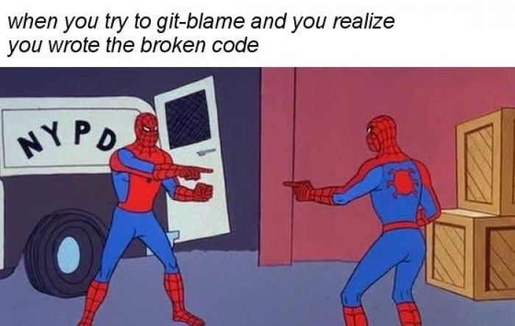
Some Lessons You Have To Learn The Hard Way

Slide 22
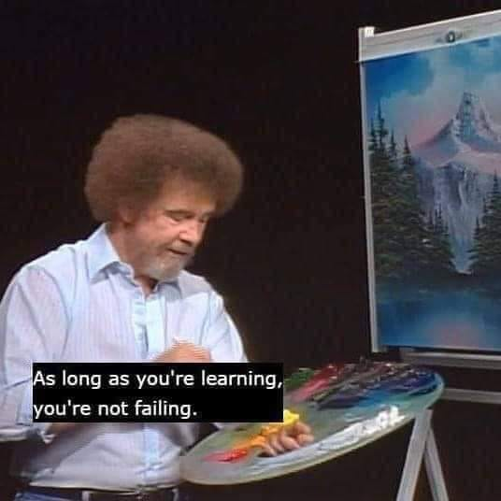
Addressing Feedback
Prioritize Changes (critical functional bugs first)
A Code Review Is About The Code, Not You
Don’t take it personally!
Ask What Could Be Improved
Ask For Clarification and Explanation
Pair Up (pair programming)

Slide 23
Giving Feedback
We’re All Learning
Ask For Clarification
Avoid “you” statements
Provide Actionable Suggestions

Slide 24
Recap and Q&A
Tonight’s Objectives:
Know what an interviewer is looking for from a live coding session
Explain the steps necessary for a successful live coding session
Know where to find prompts for live coding practice
Know how to give and receive good code review feedback

Slide 25
Assignments

Slide 26
Activity - Huddle (15 mins)
1 Minute Per Person
What You Did
What You’re Working On Next
Any Blockers

Slide 27
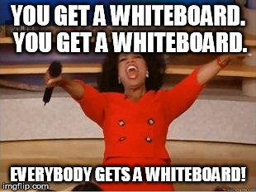
Activity - Live Coding Pair Up
Partner Up
Take Turns Live Coding
Whiteboard or Pen & Paper

Slide 28
Activity - Code Review
10-20 Minute Code Review
On-the-spot Feedback (Take Notes)

